Slide 1

COURSE: DATA SCIENCE tOPIC: Statistics INSTRUCTOR: REEMA MEMON

Slide 2
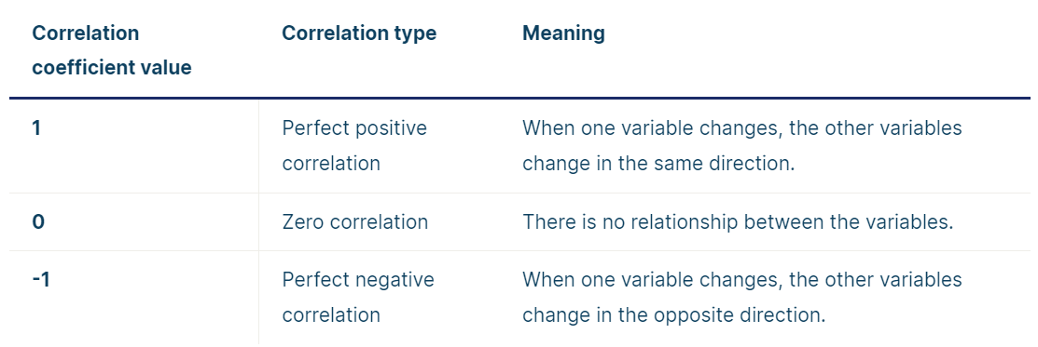
CORRELATION COEFFICIENT:
A correlation coefficient is a number between -1 and 1 that tells you the strength and direction of a relationship between variables.
In other words, it reflects how similar the measurements of two or more variables are across a dataset.

Slide 3
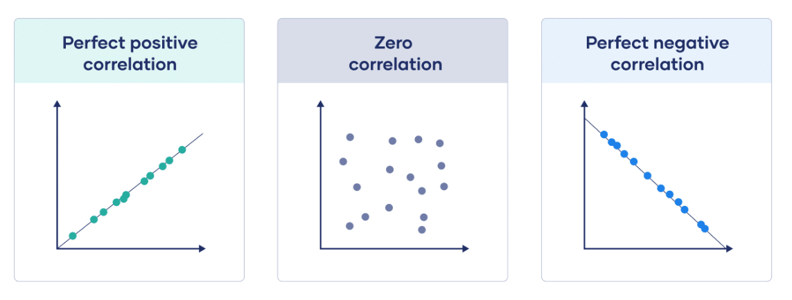

Slide 4
Correlation Coefficient Properties
The correlation coefficient is all about establishing relationships between two variables. Some properties of the correlation coefficient are as follows:
1) The correlation coefficient remains in the same measurement as in which the two variables.
2) The numerical value of the correlation coefficient will be between -1 to + 1. It is known as the real number value.
3) The negative value of the coefficient suggests that the correlation is strong and negative. And if ‘r’ goes on approaching -1, then it means that the relationship is going towards the negative side.
When ‘r’ approaches the side of + 1, then it means the relationship is strong and positive. By this, we can say that if +1 is the result of the correlation, then the relationship is in a positive state.
4) The weak correlation is signalled when the coefficient of correlation approaches zero. When ‘r’ is near zero, then we can deduce that the relationship is weak.

Slide 5
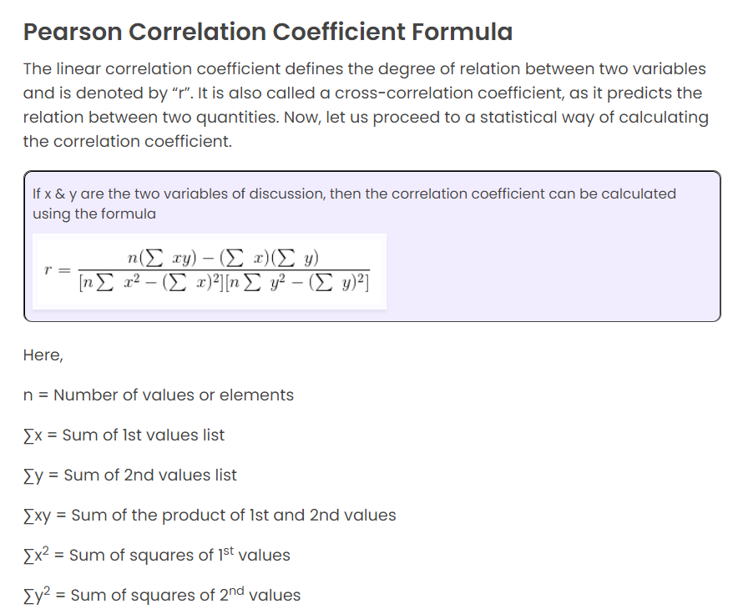

Slide 6
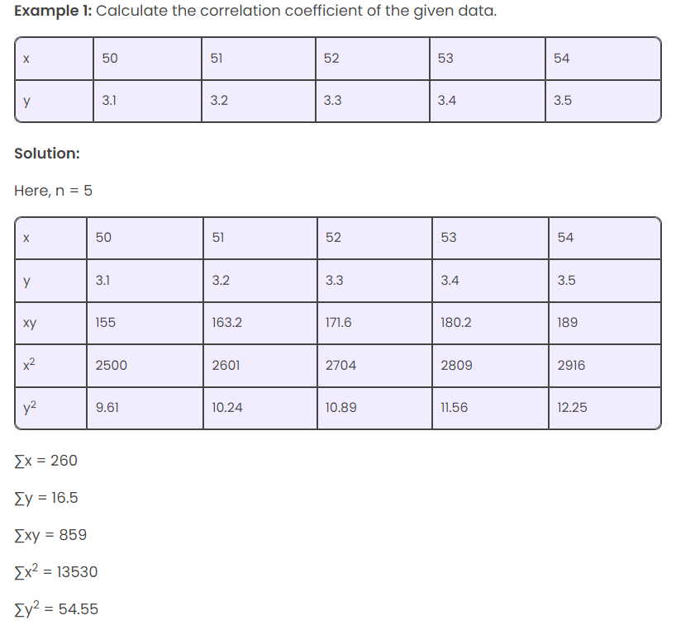

Slide 7
By substituting all the values in the formula, we get r = 1. This shows a positive correlation coefficient.
Check Yours!

Slide 8
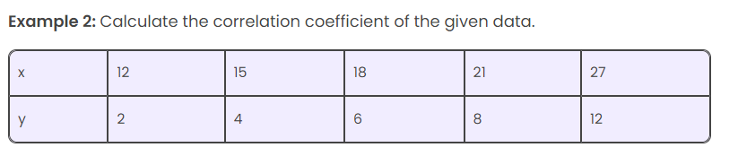

Slide 9
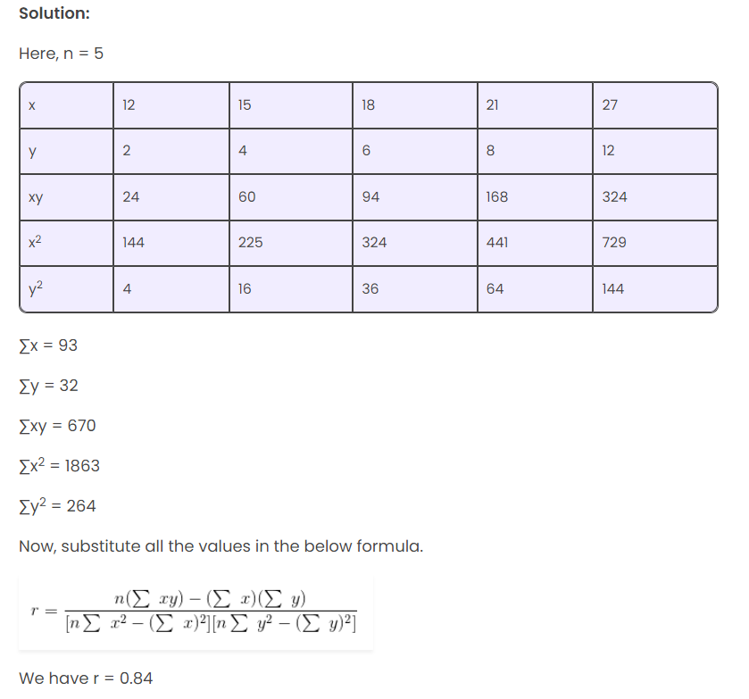

Slide 10
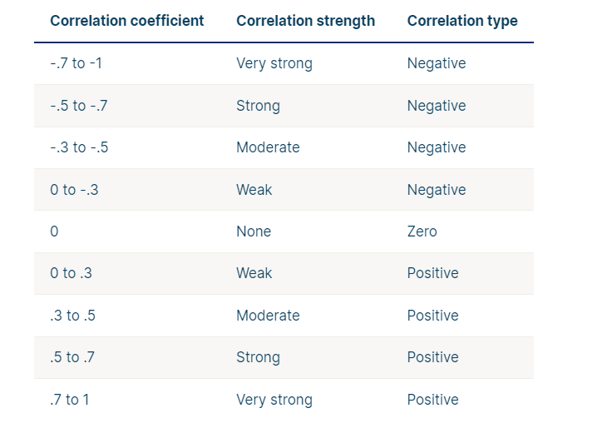

Slide 11
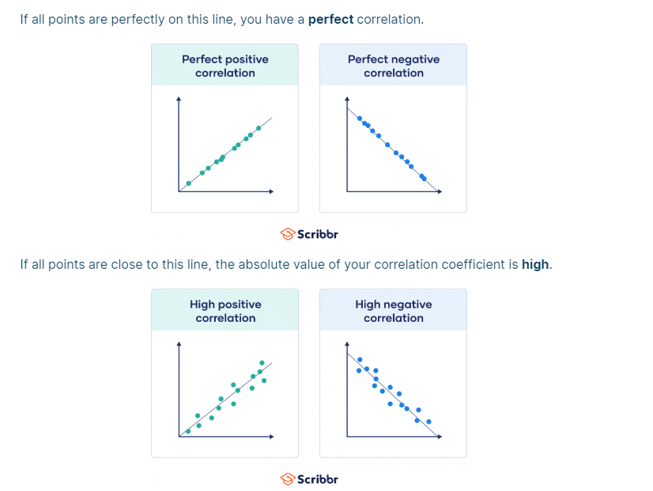

Slide 12
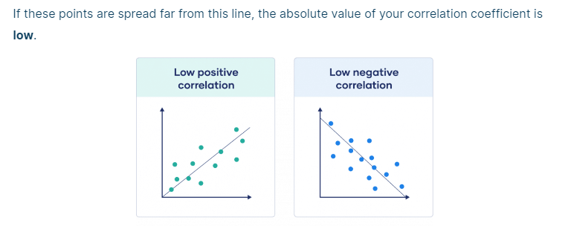

Slide 13
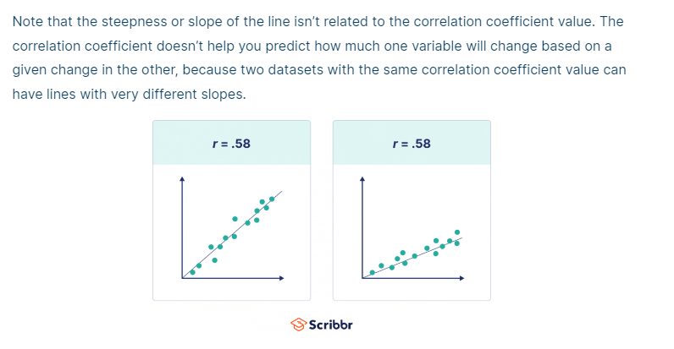

Slide 14
What is Probability?
Mathematics is the science of certainty.
Probability is the science of uncertainty.

Slide 15
A random variable is a variable whose value is unknown or a function that assigns values to each of an experiment's outcomes.
In probability and statistics, random variables are used to quantify outcomes of a random occurrence, and therefore, can take on many values. Random variables are required to be measurable and are typically real numbers.

Slide 16
Properties of a Random Variable:
A random variable can be discrete or continuous.
Example:
Tossing a fair coin.
Rolling a fair dice.

Slide 17
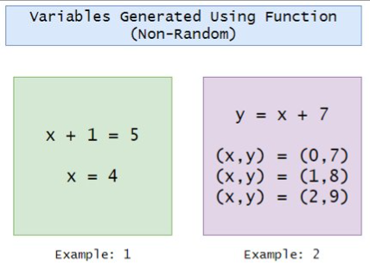
Non-Random Variables:

Slide 18
Discrete Random Variable:
A random variable is called a discrete random variable if its values can be obtained by counting.
Example:
The number of students in the class.
Your marks in your semester.
The number of planets around a star.
The number of heads after flipping x number of coins.

Slide 19
Continuous Random Variable:
Continuous random variables can represent any value within a specified range or interval and can take on an infinite number of possible values.
Example:
An experiment that involves measuring the amount of rainfall in a city over a year.
The average height of a random group of 25 people.

Slide 20
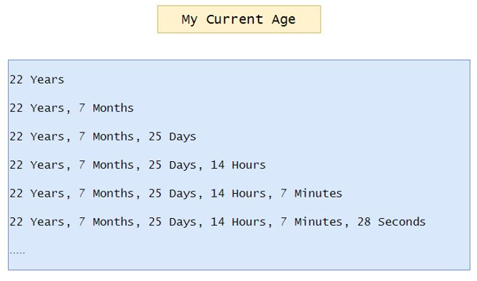
WHAT IS YOUR CURRENT AGE?

Slide 21
Sample Space:
A sample space is a collection or a set of possible outcomes of a random experiment. The sample space is represented using the symbol, “S”. The subset of possible outcomes of an experiment is called events. A sample space may contain a number of outcomes that depends on the experiment.
The sample spaces for a random experiment is written within curly braces “ { } “. There is a difference between the sample space and the events. For rolling a die, we will get the sample space, S as {1, 2, 3, 4, 5, 6 } whereas the event can be written as {1, 3, 5 } which represents the set of odd numbers and { 2, 4, 6 } which represents the set of even numbers. The outcomes of an experiment are random and the sample space becomes the universal set for some particular experiments

Slide 22
For example:
Tossing a Coin
When flipping a coin, two outcomes are possible, such as head and tail. Therefore the sample space for this experiment is given as
Sample Space, S = { H, T } = { Head, Tail }
Tossing 3 Coins:
Sample space for tossing three coins is written as
Sample space S = { HHH, HHT, HTH, HTT, THH, THT, TTH, TTT}

Slide 23
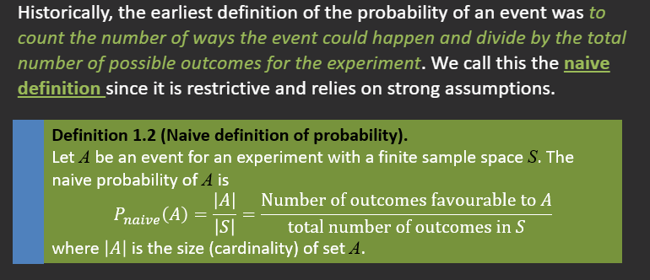
Definition of Probability:

Slide 24
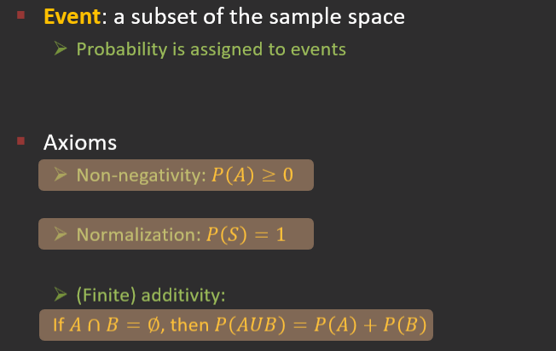

Slide 25
Example:
1. Two coins are tossed 500 times, and we get:
Two heads: 105 times
One head: 275 times
No head: 120 times
Find the probability of each event to occur.
Solution: Let us say the events of getting two heads, one head and no head by E₁, E₂ and E₃, respectively.
P(E₁) = 105/500 = 0.21
P(E₂) = 275/500 = 0.55
P(E₃) = 120/500 = 0.24
The Sum of probabilities of all elementary events of a random experiment is 1.
P(E₁)+P(E₂)+P(E₃) = 0.21+0.55+0.24 = 1

Slide 26
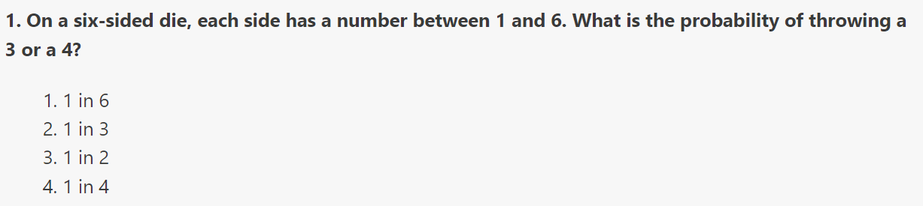
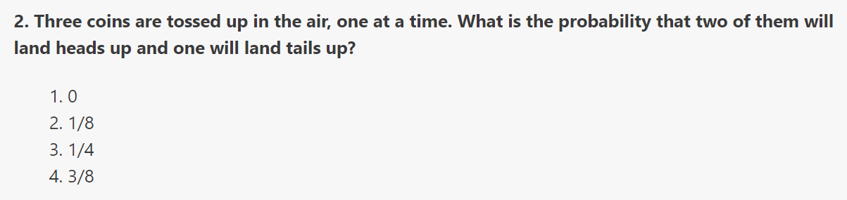
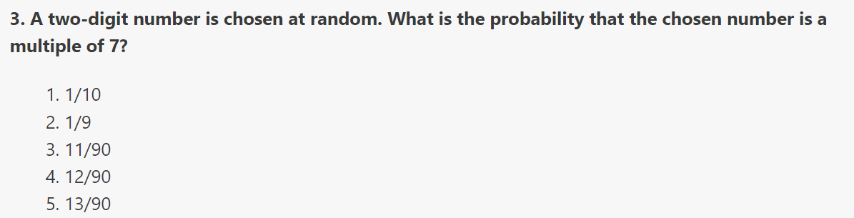
Questions:

Slide 27
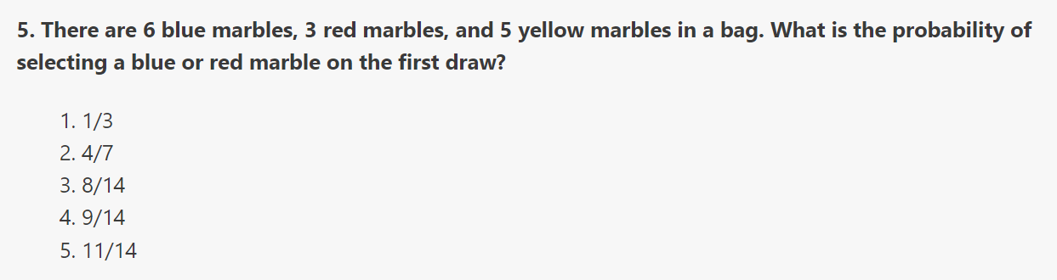
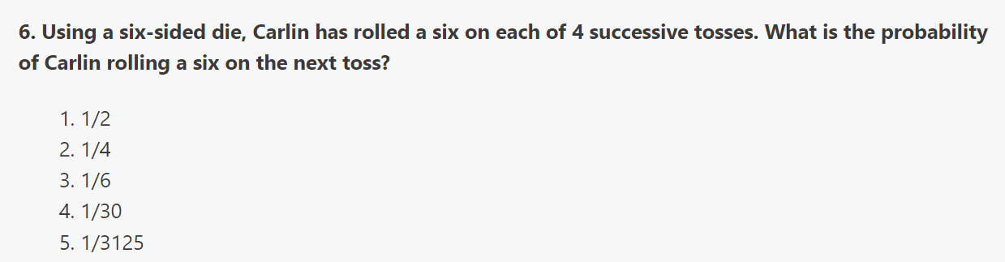

Slide 28
Answers and Explanations:
1. B: On a six-sided die, the probability of throwing any number is 1 in 6. The probability of throwing a 3 or a 4 is double that, or 2 in 6. This can be simplified by dividing both 2 and 6 by 2.
Therefore, the probability of throwing either a 3 or 4 is 1 in 3.
2. D: Shown below is the sample space of possible outcomes for tossing three coins, one at a time. Since there is a possibility of two outcomes (heads or tails) for each coin, there is a total of 2*2*2=8 possible outcomes for the three coins altogether. Note that H represents heads and T represents tails:
HHH HHT HTT HTH TTT TTH THT THH
Notice that out of the 8 possible outcomes, only 3 of them (HHT, HTH, and THH) meet the desired condition that two coins land heads up and one coin lands tails up. Probability, by definition, is the number of desired outcomes divided by the number of possible outcomes. Therefore, the probability of two heads and one tail is 3/8, Choice D.
3. E: There are 90 two-digit numbers (all integers from 10 to 99). Of those, there are 13 multiples of 7: 14, 21, 28, 35, 42, 49, 56, 63, 70, 77, 84, 91, 98.

Slide 29
5. D: Use this ratio for probability:
Probability = Number of Desired Outcomes
Number of Possible Outcomes
There are 6 blue marbles and 3 red marbles for a total of 9 desired outcomes. Add the total number of marbles to get the total number of possible outcomes, 14. The probability that a red or blue marble will be selected is 9/14.
6. C: The outcomes of previous rolls do not affect the outcomes of future rolls. There is one desired outcome and six possible outcomes. The probability of rolling a six on the fifth roll is 1/6, the same as the probability of rolling a six on any given individual roll.

